Slide 1

Data analysis project
Nipun Kumar

Slide 2
Tasks:
Using Analytics for improving financial performance.
Segmentation and Classification of customers.
Clustering.
Analytics for automating operations.

Slide 3
Introduction
ABC Pharma is a company that produces nutritional products and branded generic pharmaceuticals. They have been in the market since last 20 years.
This helps them to enjoy the margin on their product prices.
Mostly rich people are their customers from different states.
They have seen a 5% growth frequently since last few years but other companies selling related product saw 8% growth.
Management wants to focus on marketing and its effectiveness.

Slide 4
Analytics for improving performance

Slide 8
Segmentation & classification

Slide 9
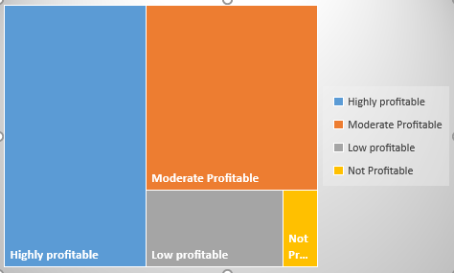
Out of customers from 30 states & UT compared, 14 of them are highly profitable, 12 of them are moderate, 4 are where profit is comparatively low and 1 state is where profit is extremely low or none at all.

Slide 10
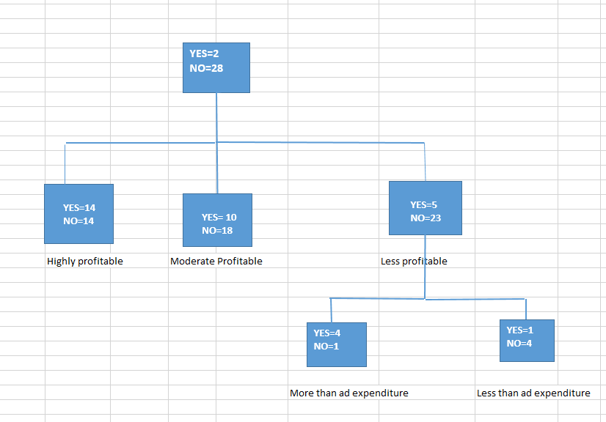
1st phase:
Have more in-store channel expenditure than online
channel expenditure (2 states were filtered out and rest
28 were selected)
2nd phase:
Profit levels are checked
States with less profitability were checked
(23 were filtered out and rest 5 are selected)
3rd phase:
Profit vs Ad expenditure checked
(4 were filtered out and 1 was selected)

Slide 11
Clustering

Slide 12
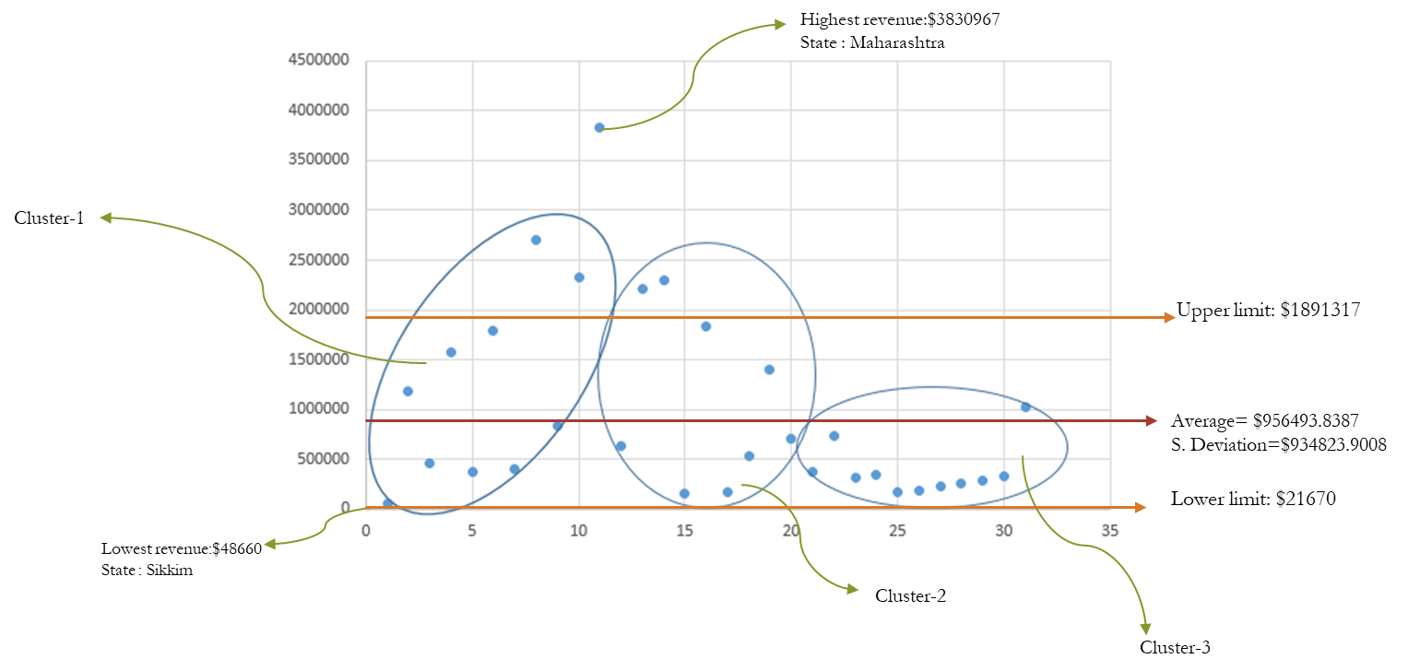

Slide 13
Insights
The ratio of profit: ad expenditure should be more so the places where it is less we should focus on the things that are not related to advertisement in those states especially the states where ratio falls less than 1.
In-store ads should be more focused on north east regions as they tend to show more profit in-store with less investment
Also considering the company main customers are rich they should focus on online channel costs/ads more; especially in places like Maharashtra.
Ladakh seems to have the best rev/exp ratio which shows that its method of getting customers is best of all.

Slide 14
THANK YOU
Nipun Kumar
nipunkr2003@gmail.com
8106675500

